Slide 1

KIANA CONSULTING PHASE-I REPORT
3 x Zones

Slide 2
CONTENT
EMPATHIZE
TEST
DEFINE
PROTOTYPE
IDEATE

Slide 3
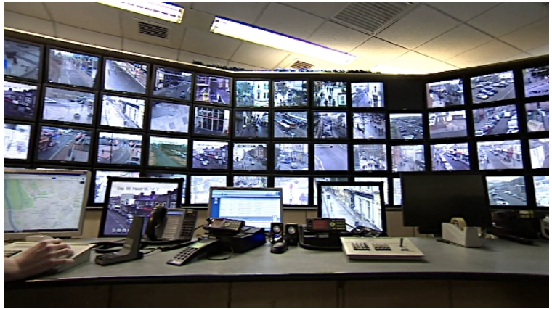
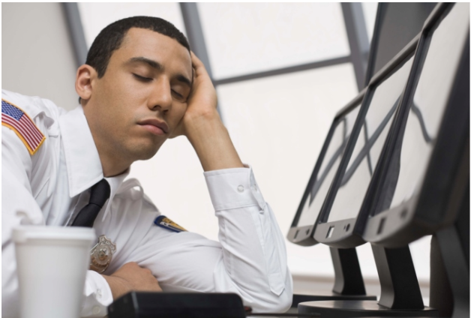
CURRENT SITUATION
EMPATHIZE
DEFINE
IDEATE
PROTOTYPE
TEST

Slide 4
CURRENT SITUATION
EMPATHIZE
DEFINE
IDEATE
PROTOTYPE
TEST
Problem 2: Elevator
Power Outage at Muritala Mohammed Airport, Lagos Traps People Inside Elevator for 45 Minutes![1]
Problem 3: Restricted Area
On May 7, 2020, Southwest Airlines Flight 1392 struck and killed a pedestrian while landing on runway 17R at Austin–Bergstrom International Airport. The victim, who was not a badged airport employee, was subsequently confirmed to have breached airport security in reaching the runway.
Problem 4: Devices stolen from airport
According to police, unknown suspects(s) entered the 40 acre Mauka Extension Project construction site in Daniel K. Inouye Airport and proceeded to steal approximately $100K in hand tools and construction equipment on December 20th at 11 p.m.

Slide 5
CURRENT SITUATION
EMPATHIZE
DEFINE
IDEATE
PROTOTYPE
TEST
citation
1.https://www.bellanaija.com/2012/05/power-outage-at-muritala-mohammed-airport-lagos-traps-people-inside-elevator-for-45-minutes/
2.https://www.wikiwand.com/en/Airport_security#/Notable_incidents
3.https://www.khon2.com/local-news/over-100k-worth-of-equipment-stolen-from-airport-construction-site/

Slide 6
890,758
EMPATHIZE
DEFINE
IDEATE
PROTOTYPE
TEST
Number of devices appear in TPS1 Level 2

Slide 7
EMPATHIZE
DEFINE
IDEATE
PROTOTYPE
TEST
DETECT ABNORMAL MOVEMENT & DENSITY
Abnormal
dispersion/concentration
of the crowd
Abnormal staying
at fixed location
Abnormal
high/low flow
of customer traffic
Unrecorded devices in restricted areas
Abnormal movement of facilities

Slide 8
01
02
MAINTENANCE NEEDS
EMERGENCY SITUATION
EMPATHIZE
DEFINE
IDEATE
PROTOTYPE
TEST
GOAL：Enhance the efficiency of detection and response time
Notes:
警报系统 Enhance detection and response efficiency to emergencies and maintenance needs.

Slide 9
EMPATHIZE
DEFINE
IDEATE
PROTOTYPE
TEST
SPECIFIC APPLICATION
“When there’s a fire incident or bomb threat, people will be running away from the site.”
“When there’s medical related emergency, the crowd will be gathering at one location.”
“If a non-airport device appears in a place that is not open to the public, that might be guests entering restricted areas, either by mistake or on purpose.”
“When a person is stuck in an elevator, the device remains at the same location for a long period of time.”
“When the restroom or other facilities needs maintenance, the passenger flow will drop significantly.”
“An airport device moves out of its normal range may be associated with equipment stealing.”

Slide 10
OPERATION
SAFETY
Efficiency
COST
EMPATHIZE
DEFINE
IDEATE
PROTOTYPE
TEST
ADVANTAGES
Prevent maintenance issue to ensure airport’s operational continuity
Ensure airport’s and
passengers’ safety
Reduce response time for emergency
Reduce manual labor cost & security cost.

Slide 11
EMPATHIZE
DEFINE
IDEATE
PROTOTYPE
TEST
TECH APPROACH
Define the airport
fixed devices
Determine the crowd density in divided areas
STEP 02
STEP 04
STEP 01
STEP 03
Divide the airport area into several blocks
Group data by its time period

Slide 12
EMPATHIZE
DEFINE
IDEATE
PROTOTYPE
TEST
TECH APPROACH
Confirm the reliability of our model by determining whether any previous events were detected by our test dataset.
Determine the normal movement speed of the crowd
STEP 06
STEP 05
STEP 07
Use models to distinguish the normal and abnormal
Notes:
Time,speed, density

Slide 13
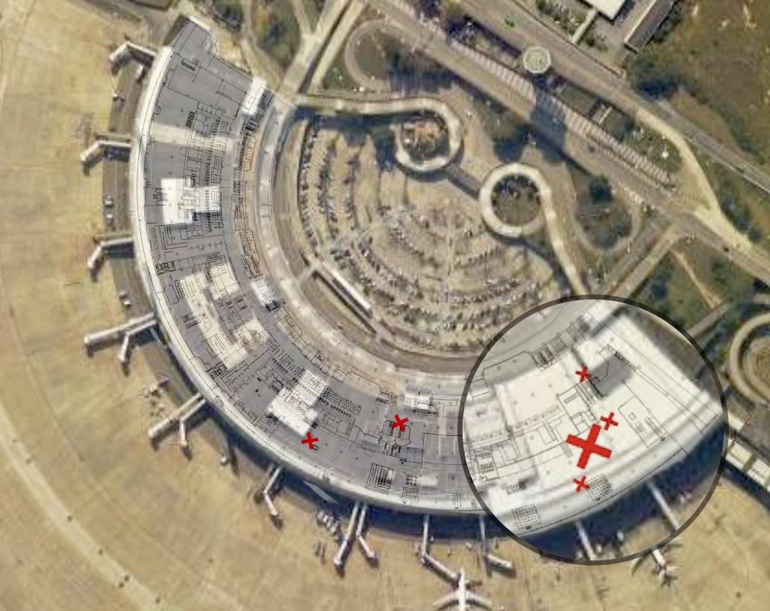
EMPATHIZE
DEFINE
IDEATE
PROTOTYPE
TEST
Fixed Devices
00:05:9e:97:19:b0 28:80:23:32:16:10 28:80:23:32:16:11 28:80:23:32:16:12 28:80:23:32:16:16 30:b5:c2:d4:c1:40 c0:25:e9:7e:d8:5c c0:25:e9:7e:d8:5d
c0:25:e9:7e:d8:5e d0:04:01:48:f9:66 fc:64:3a:24:ab:dc
MAC Address (e.g.):
Notes:
❌ 7
Fixed equipment：5个月停留4个月以上
5个月每天都在的只有3个devices。

Slide 14
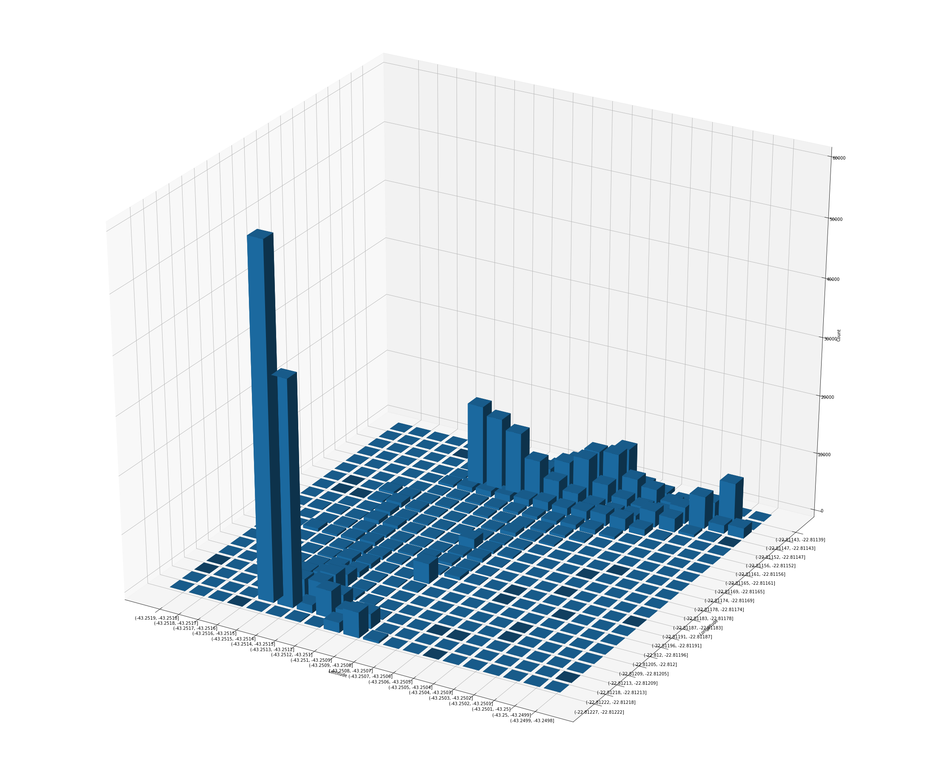
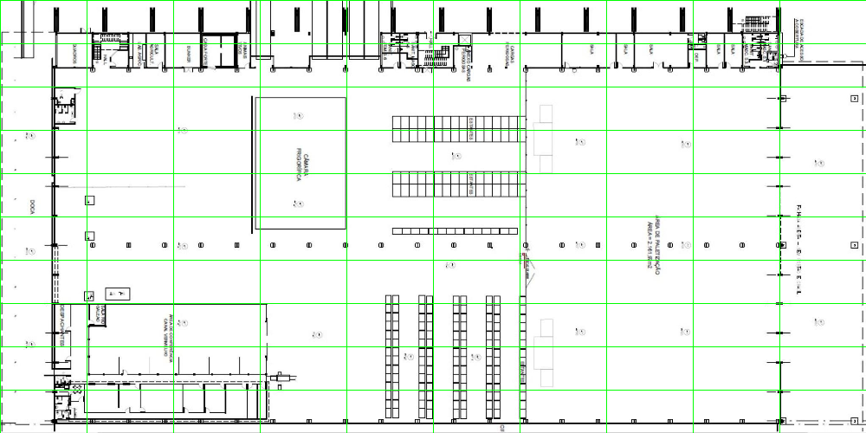
EMPATHIZE
DEFINE
IDEATE
PROTOTYPE
TEST
Crowd density by coordinates
Grids

Slide 15
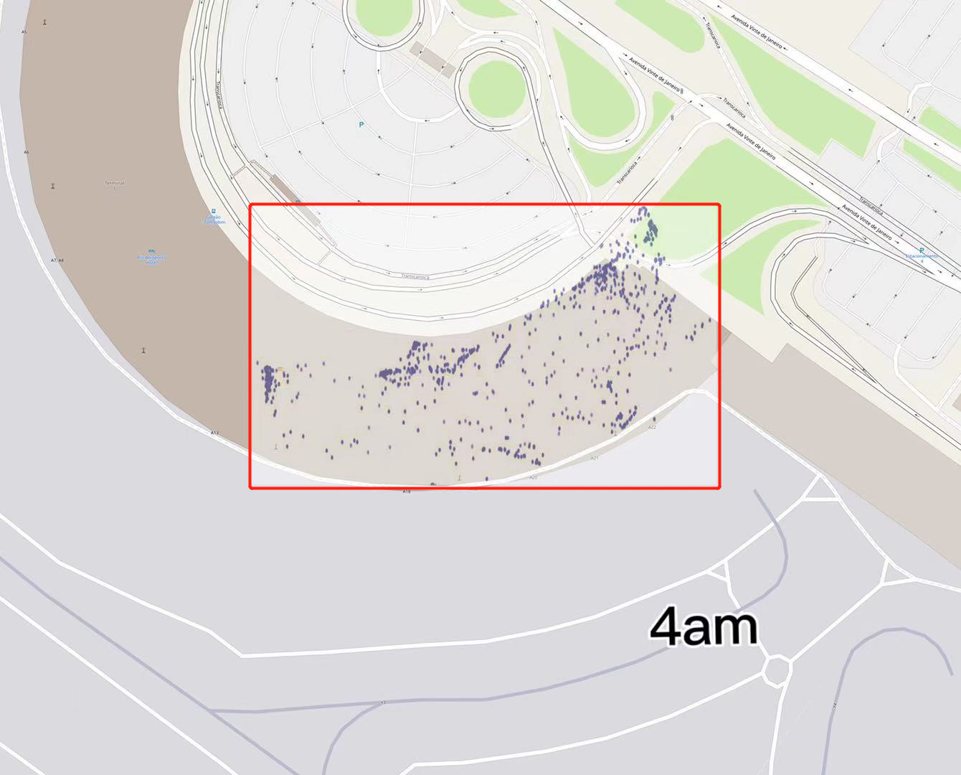
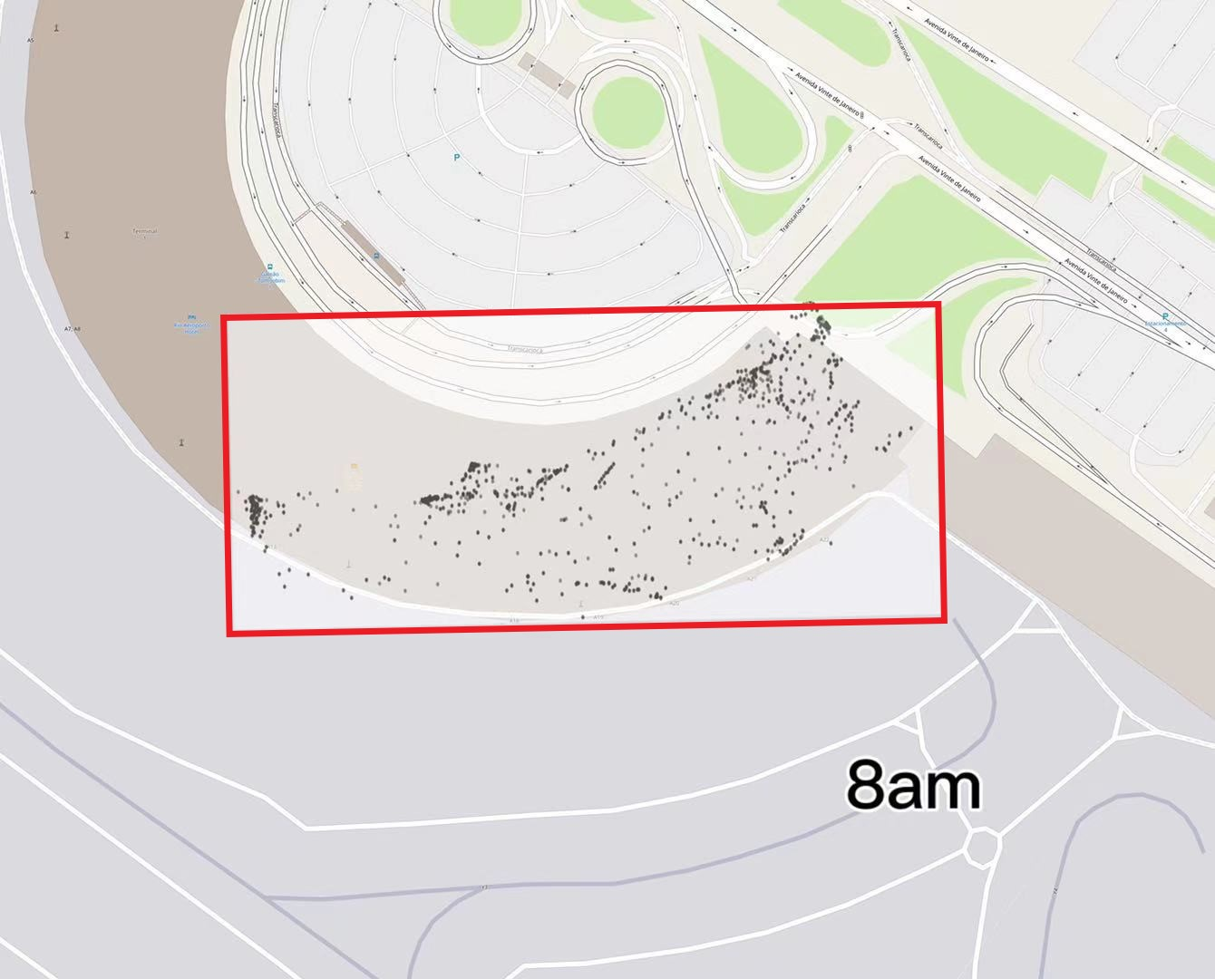
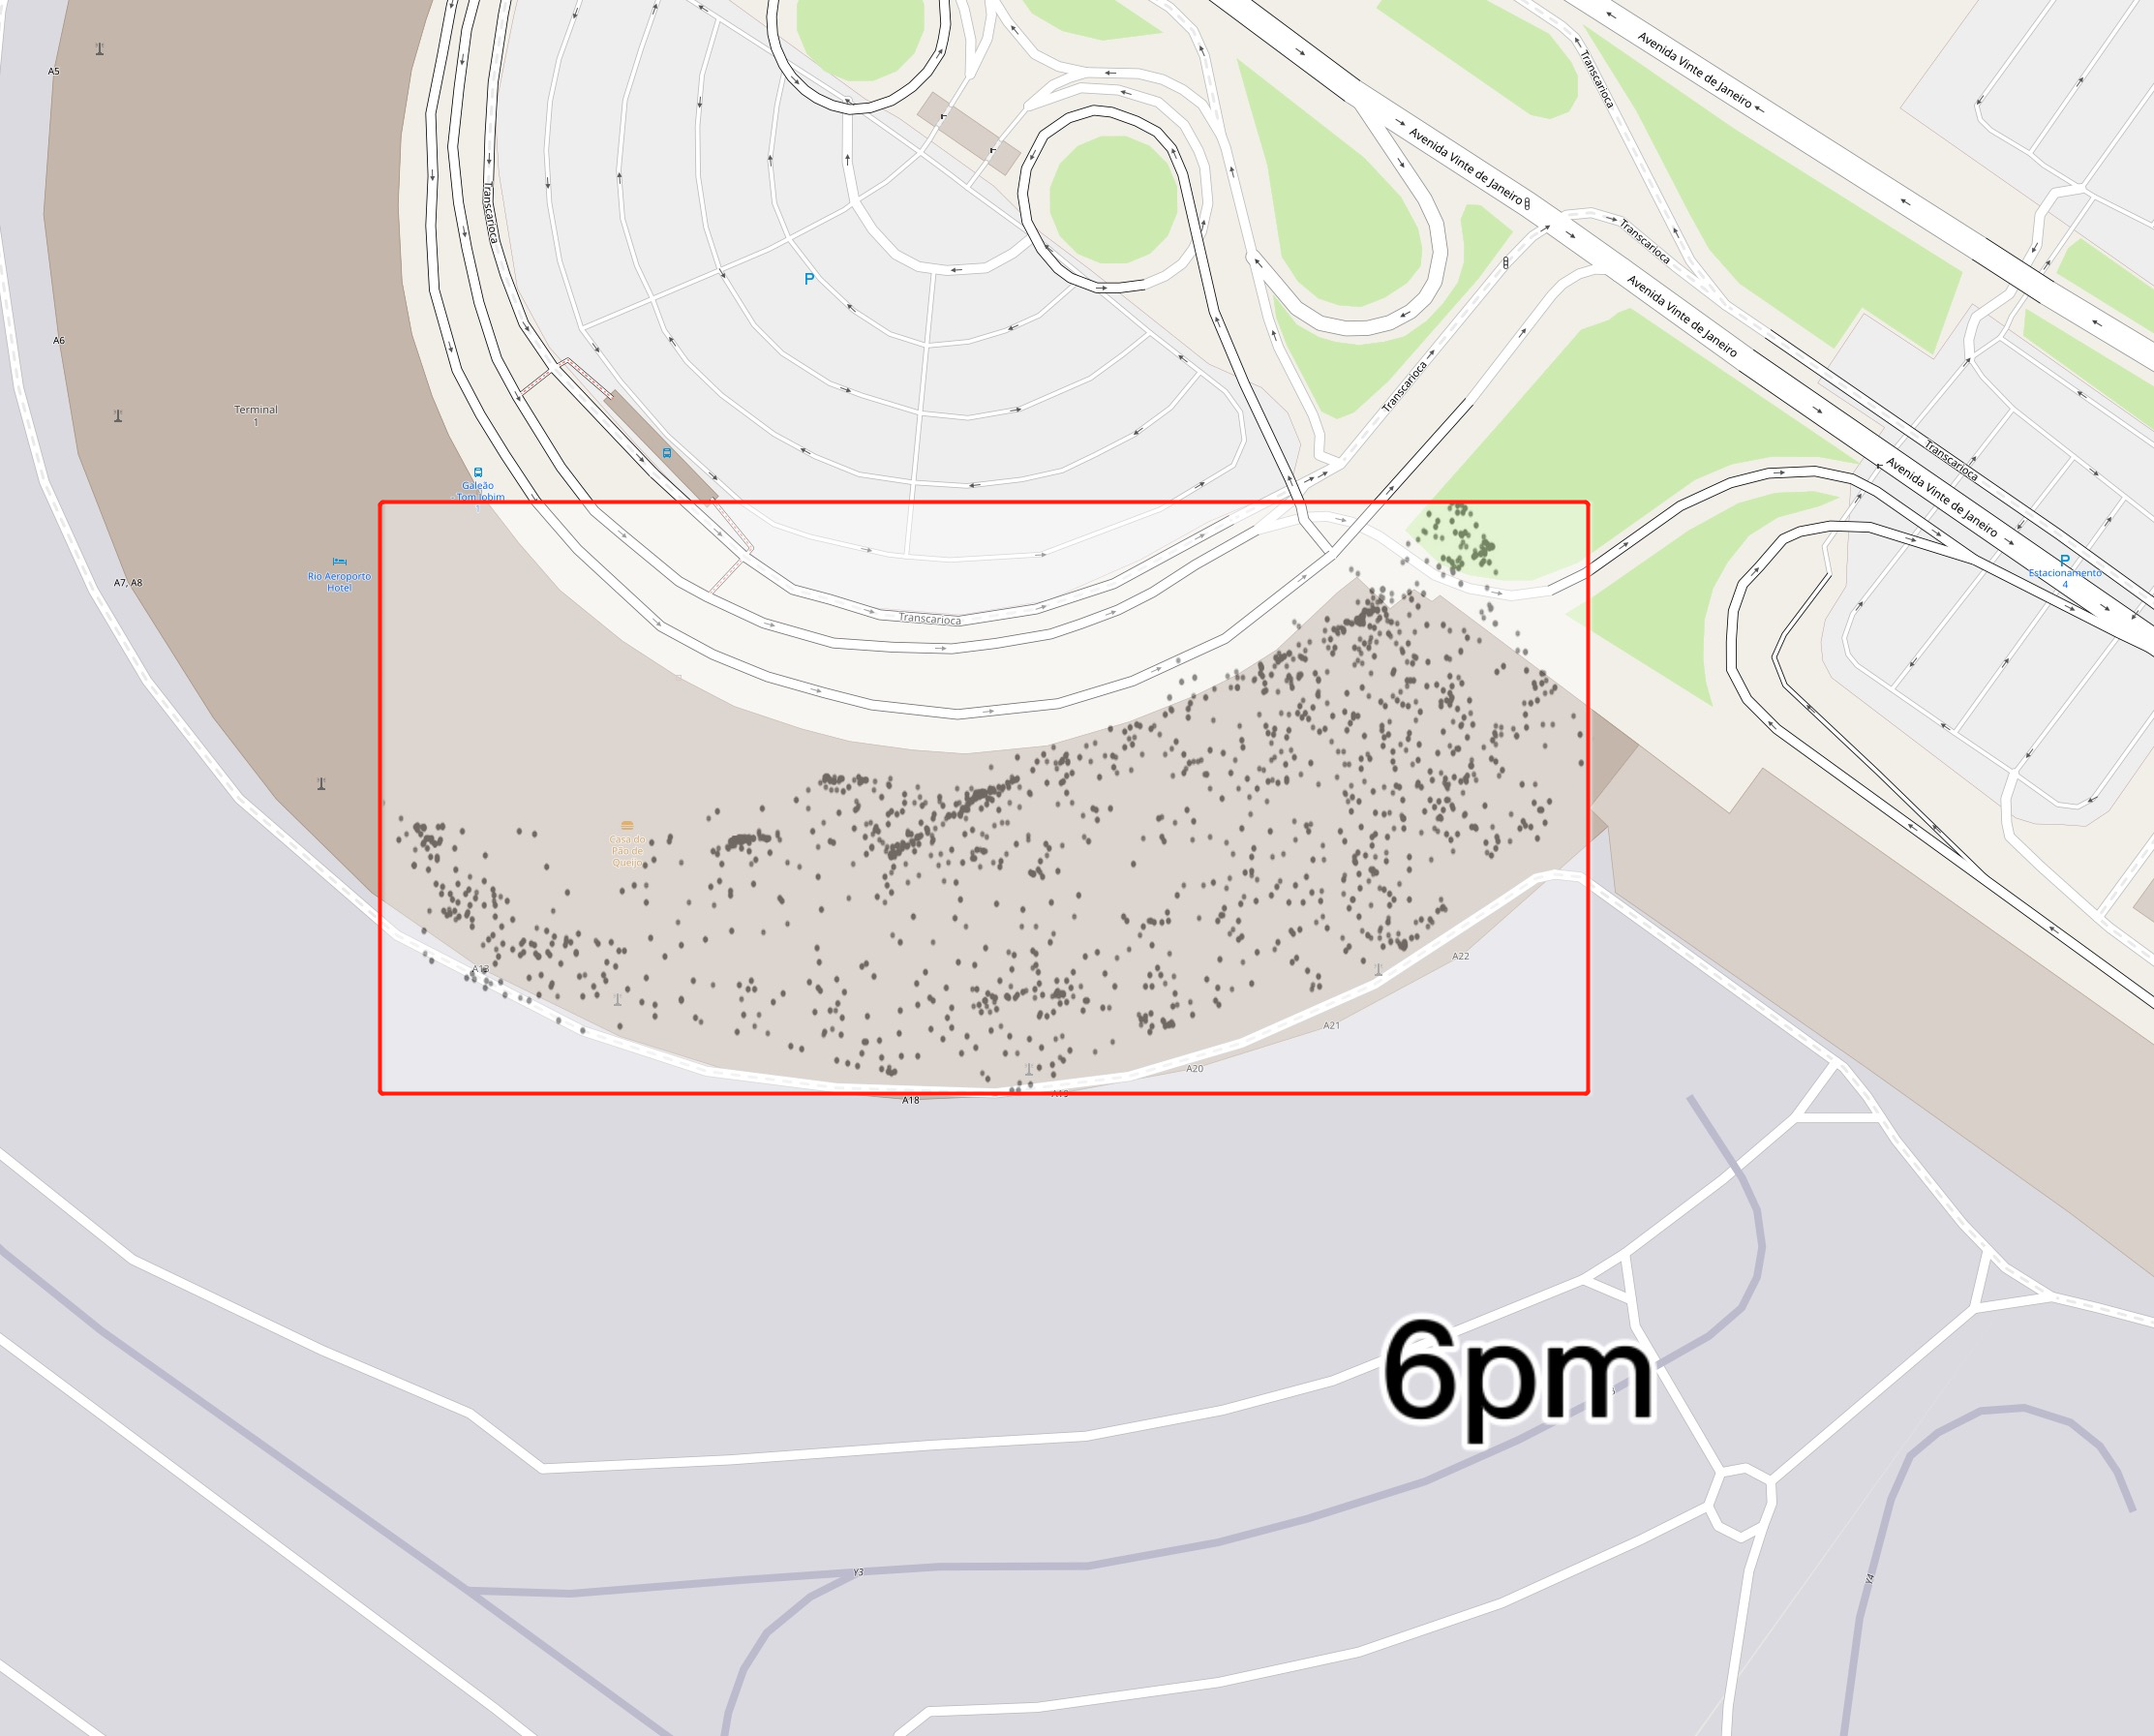
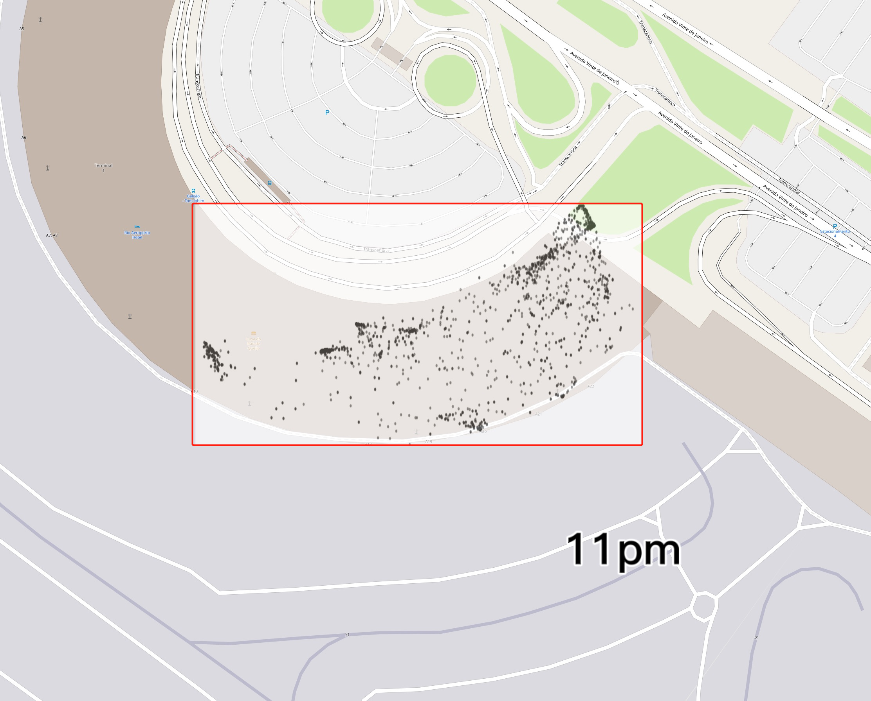
EMPATHIZE
DEFINE
IDEATE
PROTOTYPE
TEST
One day’s Crowd Density
at 4am, 8am, 6pm, and 11pm

Slide 16
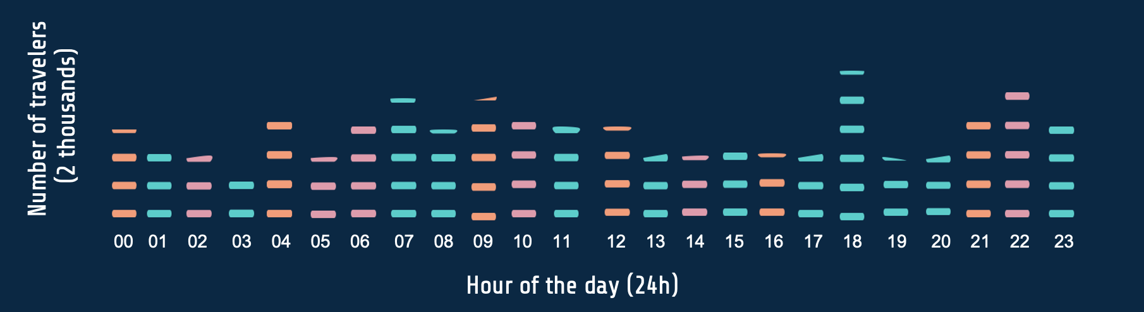
EMPATHIZE
DEFINE
IDEATE
PROTOTYPE
TEST
Average Traveler Amount by Hours

Slide 17
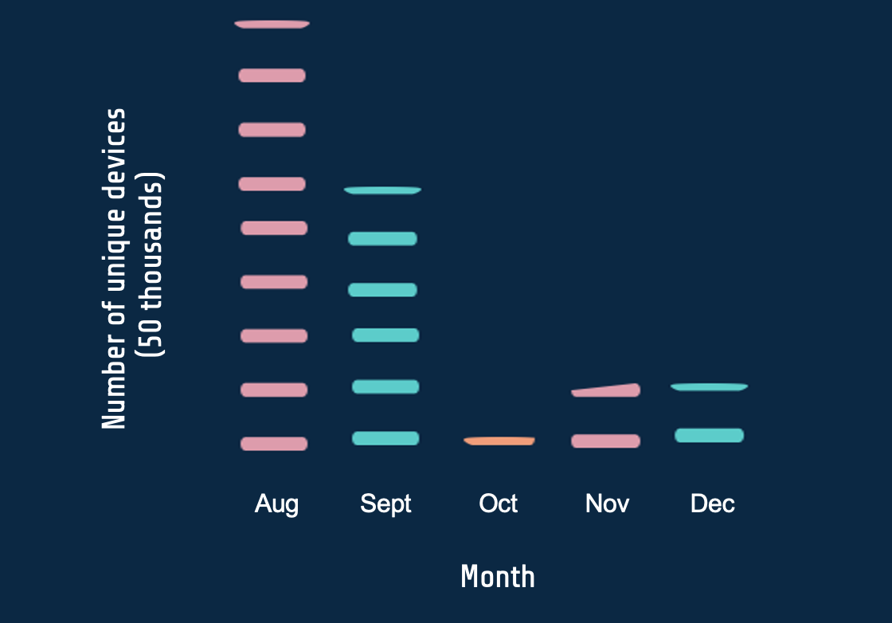
EMPATHIZE
DEFINE
IDEATE
PROTOTYPE
TEST
Amount of Unique Devices by Months

Slide 18
THANKS
Any Questions?

